Slide 1

Spring‘24 – ECEN 214 Labs
Introductory Meeting

Slide 2
Session Outcomes
Know basic lab information
Know how & where to submit lab reports
Know common labs regulations and safety protocol
Information for collection of parts kits and AD2 units
Lab teams and roster creation

Slide 3
Some Basic Lab Information

Slide 4

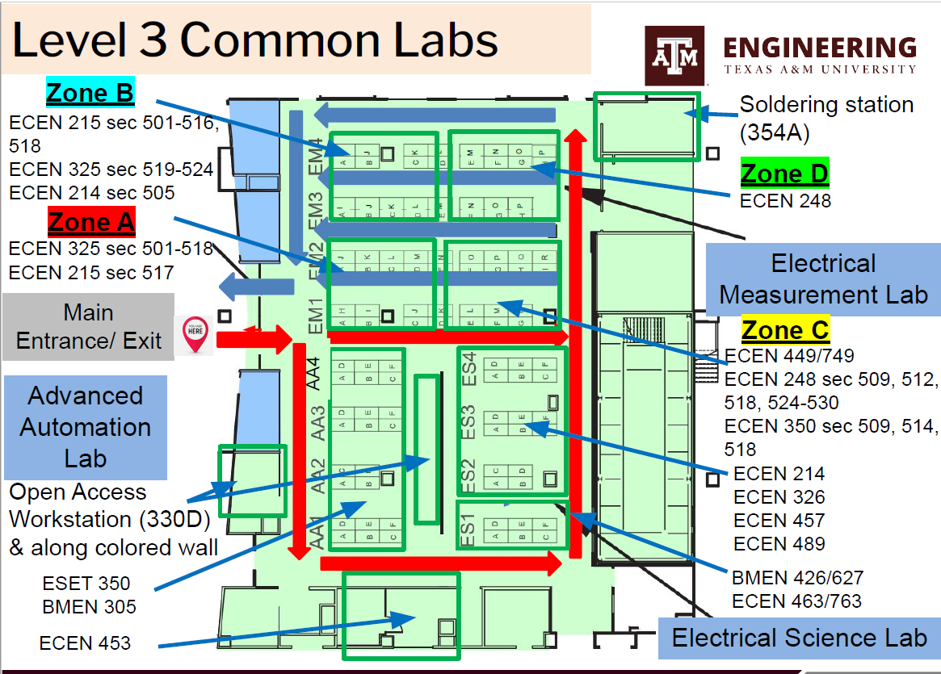
Our Lab: 3rd Floor - Lab 324
Work stations: ES3 & ES4
Sia Su, Shei. “Common Labs Orientation Safety.” 11 Jan. 2023, Texas A&M University, College Station, TX.

Slide 5
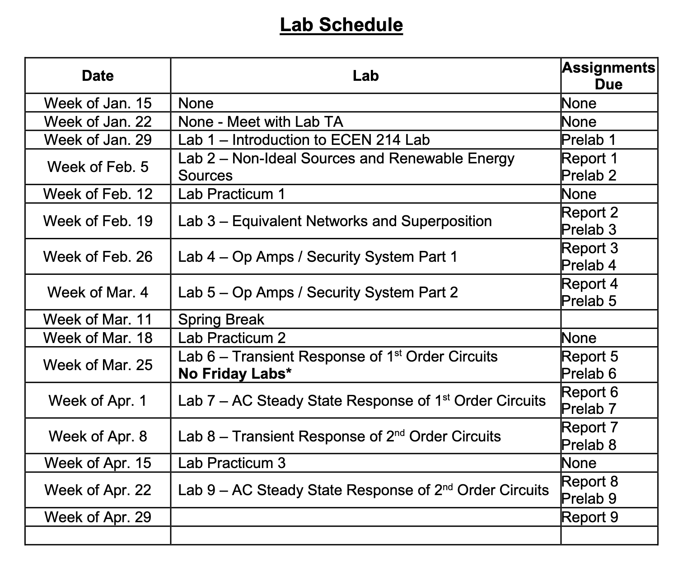
Lab Schedule
Total Reports:
9 Prelabs
9 Postlabs
Lab manuals and appendices are available on Canvas
Email me at least one day ahead if you cannot come. Have a valid excuse.
If you're getting late, email me
Include ‘ECEN 214 – Section5##’ in the subject of any email correspondence

Slide 6
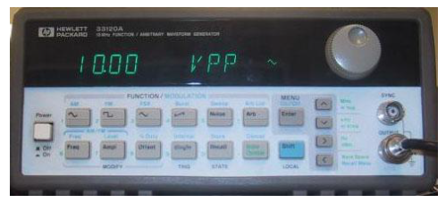
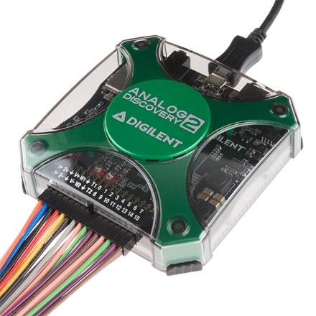

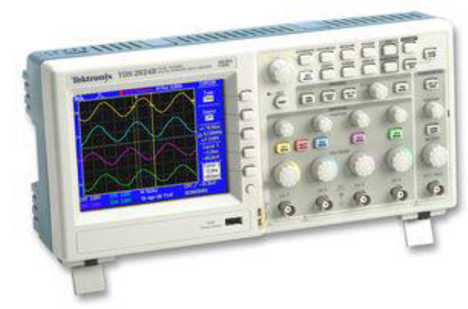
Lab measurement devices
Bench Equipment
(in-lab)
2) Portable measurement device
Analog Discovery 2 unit
3) Simulations
Multisim

Slide 7
Prelab and Postlab Reports

Slide 8
Prelabs
Prelabs are due at the start of the lab; it is an individual submission.
Every prelab is marked out of 10; no late submissions
Simulation work in prelabs: Multisim.
  Install one if you want, or Multisim online: https://www.multisim.com/
Search for: Multisim online tutorial, I will not be demonstrating it separately.
A good prelab should include: screenshots of the simulation; photos/scans of your handwritten calculations; all requested information mentioned in the lab manual

Slide 9
Postlab reports
Postlabs are due at the start of the following week’s lab;
It is an group submission; as a team you will be using the lab equipment in rotation. It is your responsibility to split the lab report tasks among yourselves and ensure a complete report is submitted. Make sure at least one of you is submitting the report on time or all members in the team will lose points
Every postlab is marked out of 100 points; late submissions will receive -10% penalty for every 24 hours of delay
Make sure to record raw data on a record sheet (hardcopy) during the lab time.
Include the cover page mentioning the lab number and title, names of authors, date performed and date submitted
A good postlab report must include: all recorded data taken during lab, good representation of data (charts/graphs etc), conclusion with scientific reasoning,

Slide 10
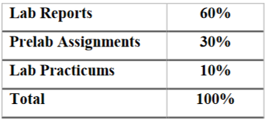
Submission information
The format of lab reports: convert your scanned/word documents to pdf format only
Upload the pdf file on Canvas (no paper submissions):
Filename: Prelab#_YourName_Section# Postlab#_YourName_Section#
If you need help with prelabs/postlabs, attend office hours
Grading Criteria:
Any issues with graded post-lab reports must be related to your TA within 1week of receiving them

Slide 11
Parts kits and AD2 Units

Slide 12
Parts kits and AD2
Each student will receive their own parts kit. No returns required. You need to bring your own batteries. (Two AAs and one 9V)
Each student will sign off an AD2 unit. This MUST be returned at the end of the semester
I will be handing out parts kits today

Slide 13
Common Labs Regulations

Slide 14
Rules from common labs
Students can only come for in-lab sessions as scheduled, no walk-ins will be allowed.
Students are only permitted to enter labs 5 mins before the labs start.
Lab session will need to be completed on time, so make sure to you arrive on time.
Be sure to come in proper attire (PPE) to the lab.
Do not start an experiment without TAs/ support staff supervision.
Sia Su, Shei. “Common Labs Orientation Safety.” 11 Jan. 2021, Texas A&M University, College Station, TX.

Slide 15
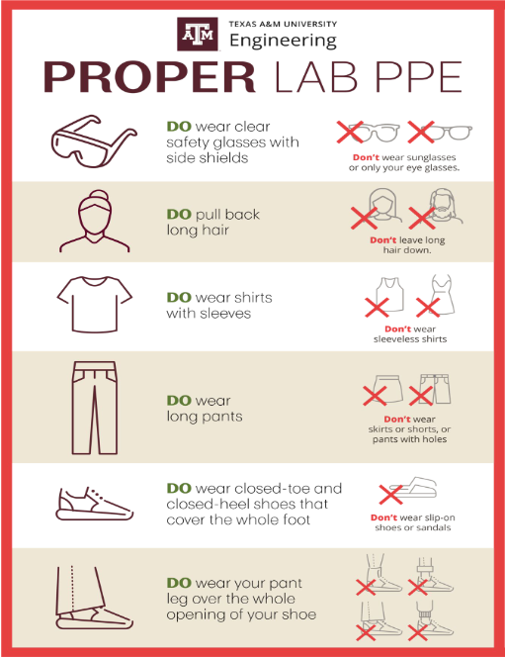

Slide 16
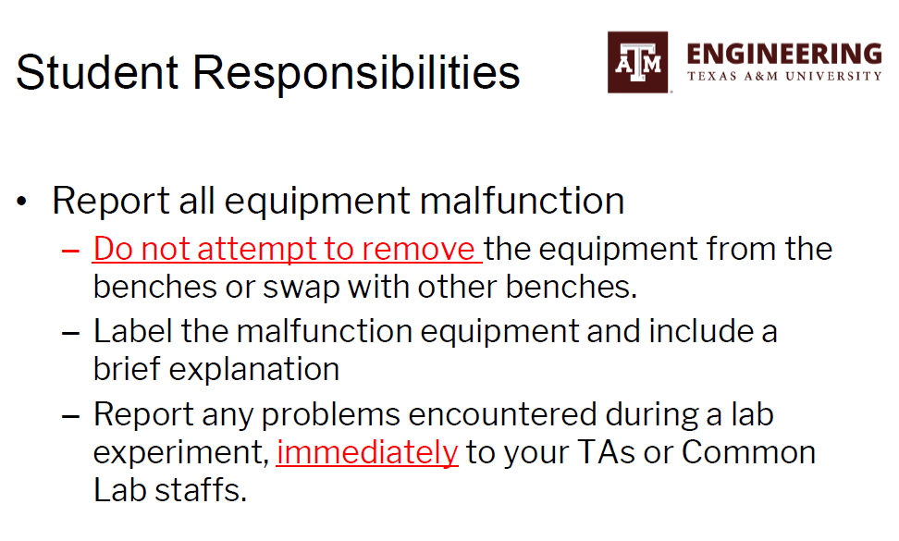
Sia Su, Shei. “Common Labs Orientation Safety.” 11 Jan. 2021, Texas A&M University, College Station, TX.

Slide 17
Lab teams and roster…

Slide 18
Thank You!

